Slide 1

Hotel Network Infrastructure Design
Using Cisco Packet Tracer
Hotel Network Topology
Presented by:
Abdul Rafay (Roll No: 243705)
Subject: Computer Network
Submitted To: Mr. Mohammad Azam
Section: Bs Cyber Security – A

Slide 2
Project Overview
This project presents the design of a secure and scalable hotel network.
The network is implemented using Cisco Packet Tracer.
It supports wired and wireless users across multiple hotel departments.

Slide 3
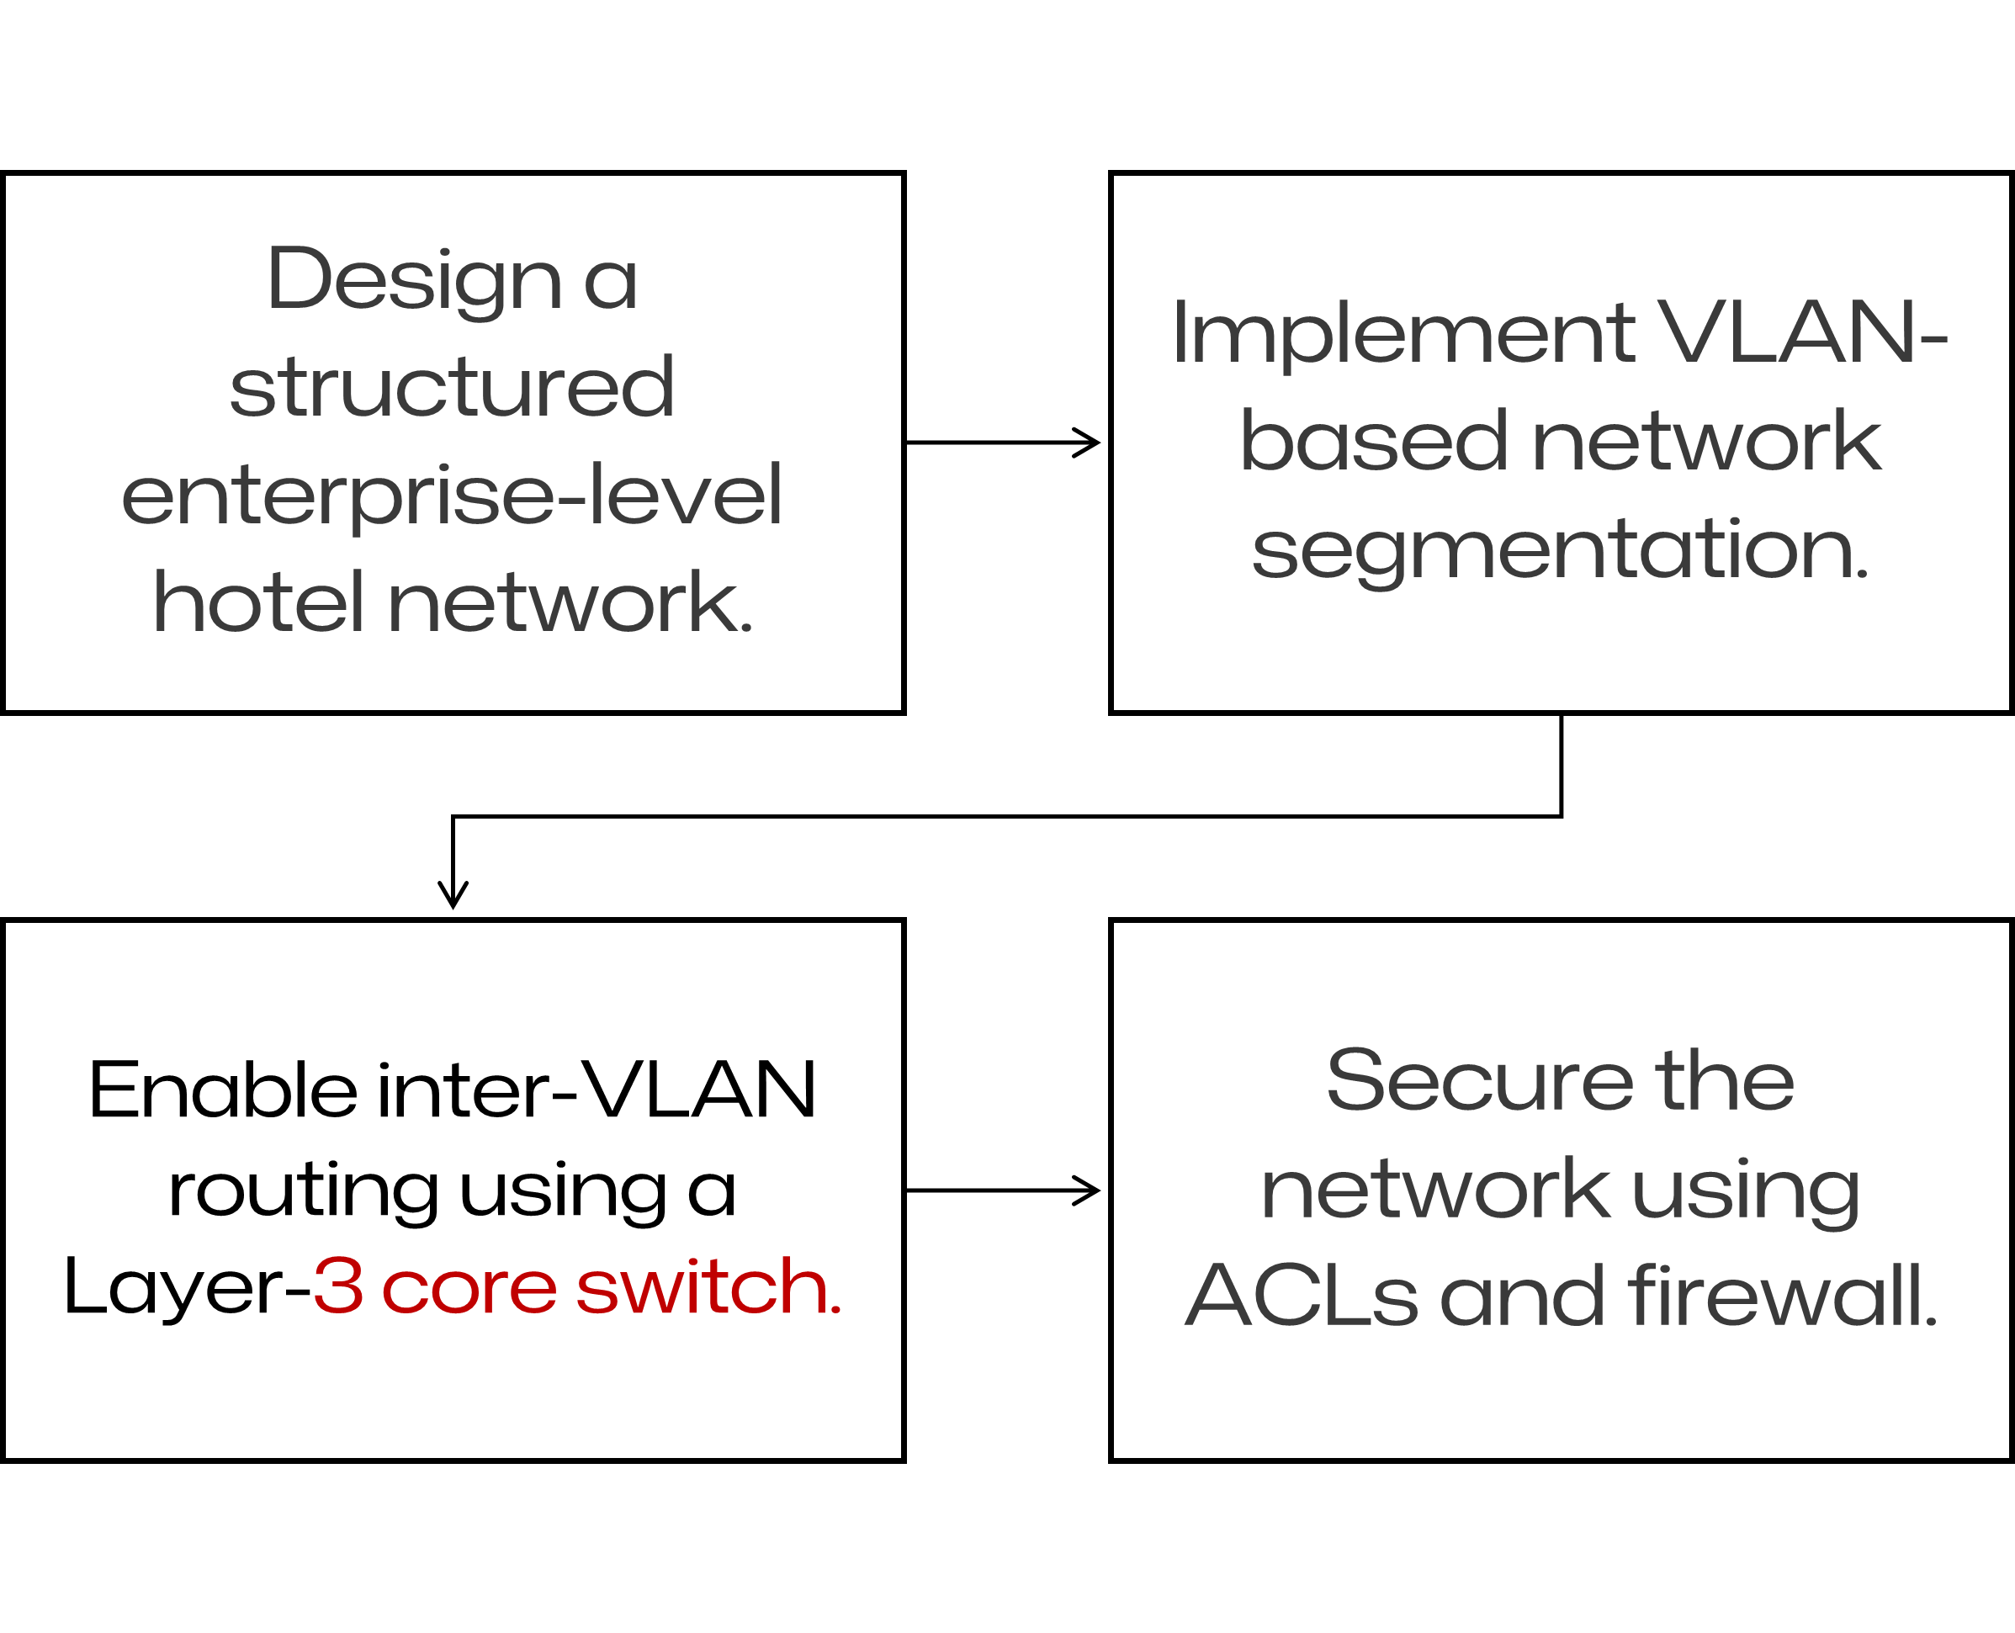
Project Objectives

Slide 4
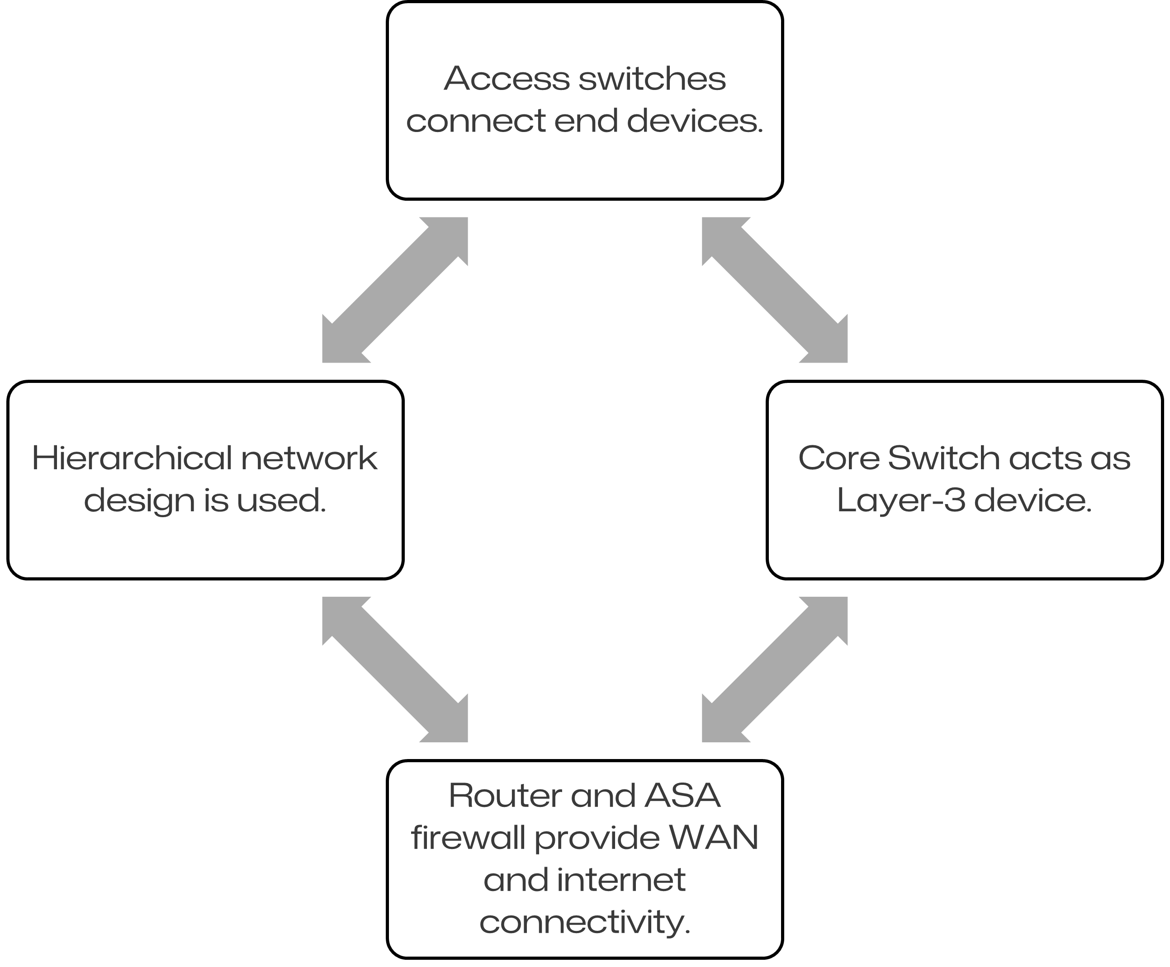
Network Architecture

Slide 5
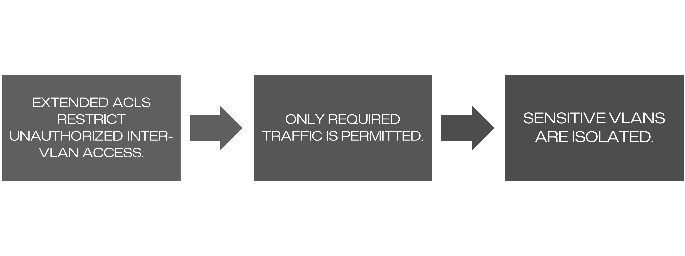
Security & Traffic Control

Slide 6
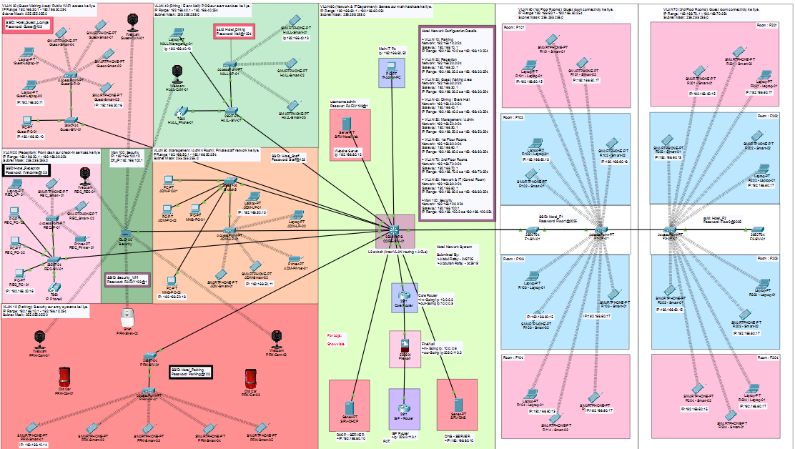
Complete Network Topology
This topology represents the complete hotel network layout.

Slide 7
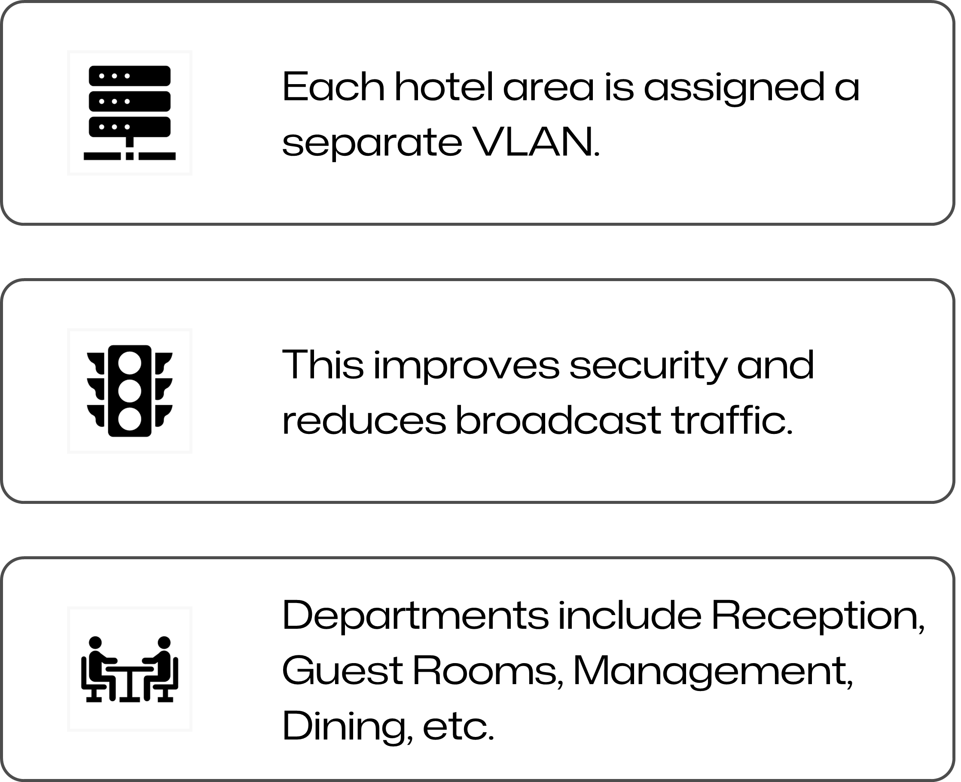
VLAN Design & Segmentation

Slide 8
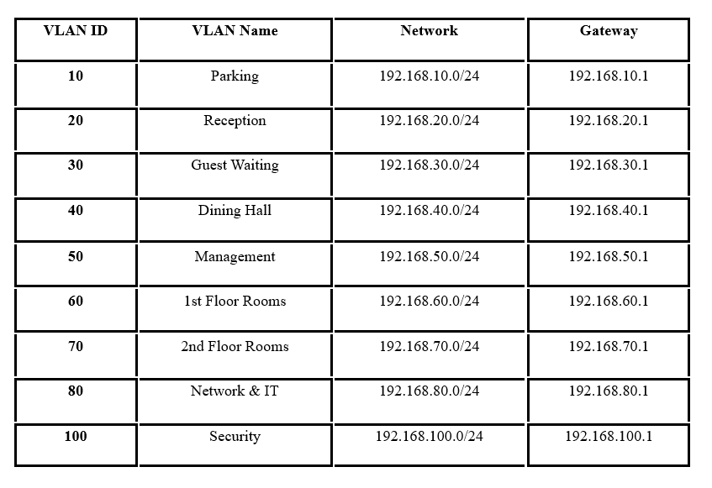
VLAN & IP Addressing Scheme:
Each VLAN uses a separate /24 subnet.
Default gateways are configured on Core Switch SVIs.

Slide 9
What we use in Our Network System.

Slide 10
Network Core & Switching Architecture
Core Infrastructure & Switching Technologies
LAN (Local Area Network):
  Integrated Admin, Guest Rooms, and Parking into a unified campus network.
VLAN (Virtual LAN):
  Created 9 VLANs (e.g., VLAN 10 Parking, VLAN 60 Rooms) for traffic segmentation .
L3 Switch (Layer 3 Switch):
  Deployed Cisco Catalyst 3560 as the Core Backbone for high-speed packet processing .
Inter-VLAN Routing:
  Enabled on the Core Switch to allow secure communication between departments.
LAN Switching:
  Used Cisco 2960 Access Switches for floor-level distribution.

Slide 11
Security, Edge & WAN Implementation
Network Security & External Connectivity
ASA (Adaptive Security Appliance):
  Implemented Cisco ASA 5506-X Firewall for stateful traffic inspection.
ACL (Access Control List):
  Applied VLAN-CONTROL to block Guest VLANs from accessing Management Servers .
NAT & PAT:
  Configured Dynamic NAT/PAT to mask internal private IPs behind a single Public IP (203.0.113.2).
WAN & ISP:
  Established a WAN link connecting the Firewall to the ISP Router (203.0.113.1).

Slide 12
Protocols, Services & Operations
IP Addressing, Protocols & Services
IPv4 & IP:
  Designed a hierarchical 192.168.x.x addressing scheme for device identification .
DHCP (Dynamic Host Configuration Protocol):
  Centralized server for automated IP assignment to Staff and Guests .
DNS (Domain Name System):
  Mapped security.safari.com to the IoT Server for ease of access.
Transport & Diagnostics:
  TCP/UDP: Used for reliable Web/DNS traffic.
  ICMP: Enabled for connectivity testing and troubleshooting (Ping).
PC (Personal Computer):
  End-user terminals deployed in Reception and Admin offices.

Slide 13
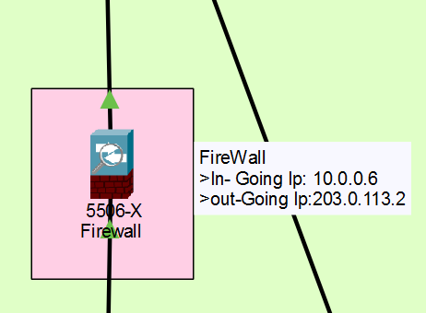
Firewall (ASA 5506) Implementation
Firewall separates internal network from ISP.
NAT (PAT) configured for internet access.
Traffic inspection policies enabled.

Slide 14
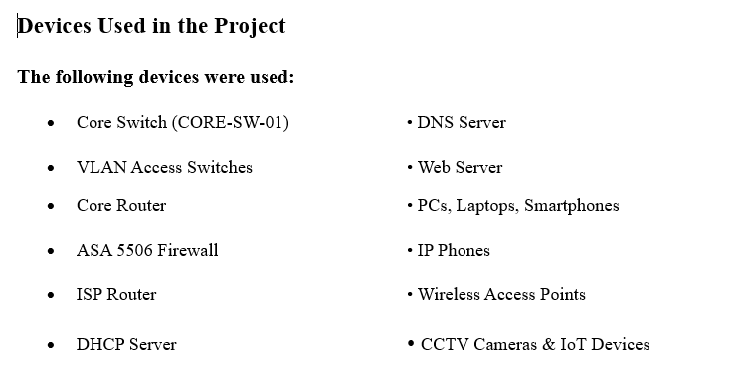

Slide 15
CABLE
CONNECTIONS:

Slide 16
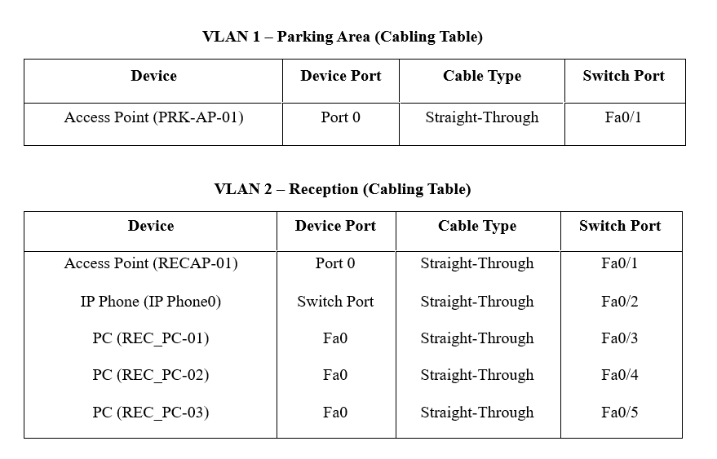

Slide 17

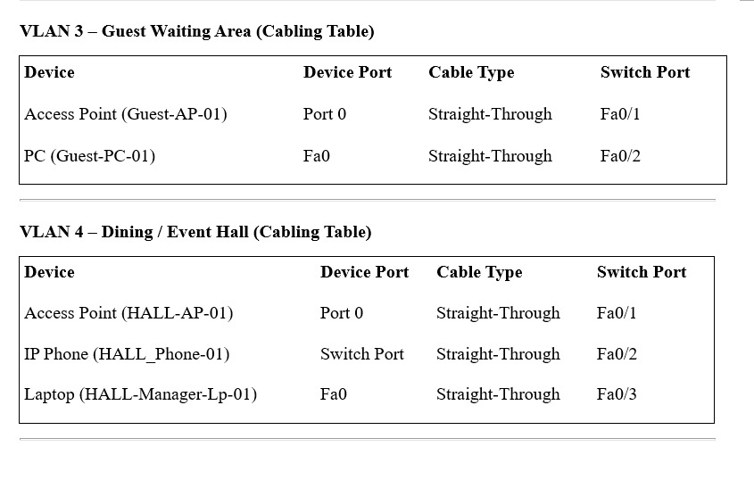

Slide 18
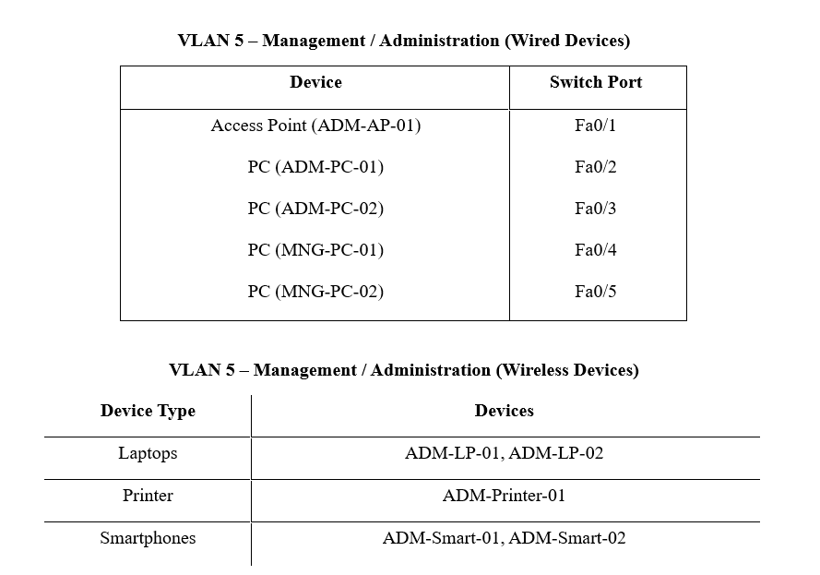

Slide 19
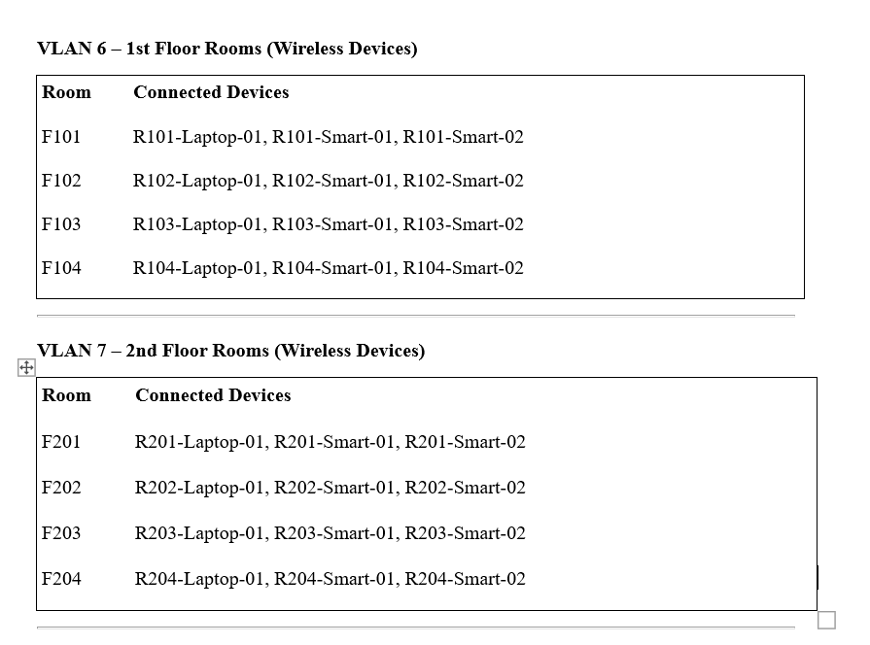

Slide 20
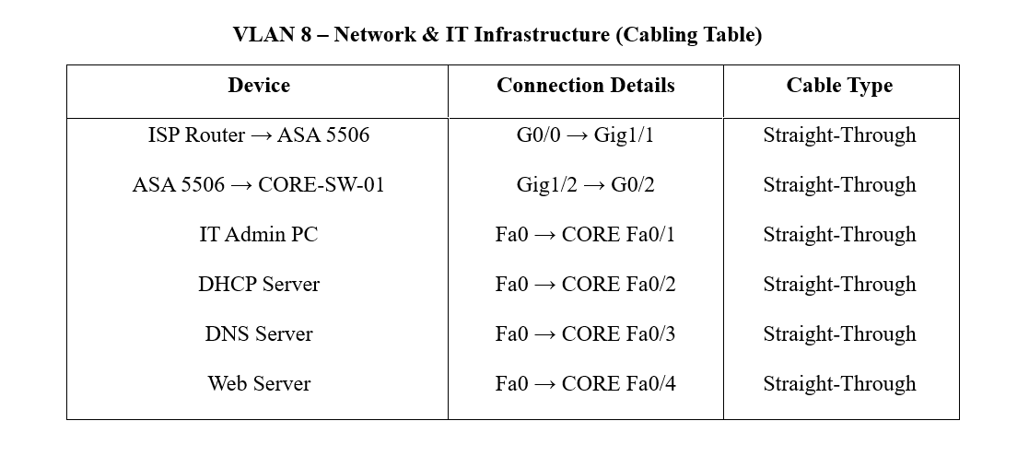

Slide 22
CONFIGRATIONS:

Slide 23
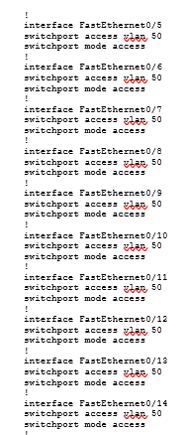
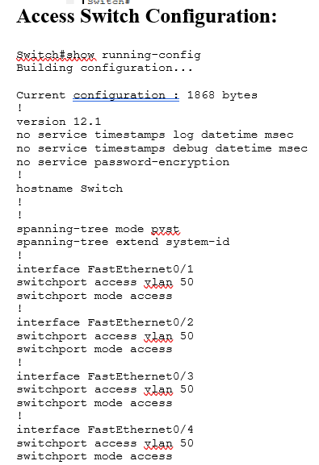
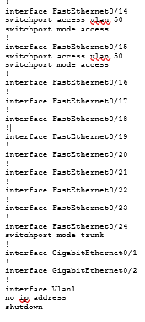

Slide 24
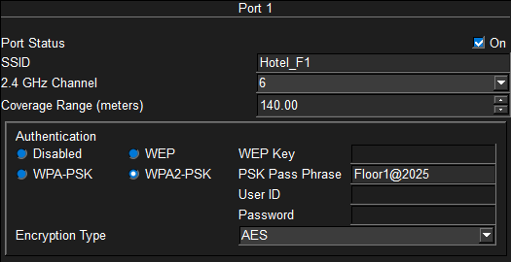
Access Switch Configuration
Access ports assigned to appropriate VLANs.
802.1Q trunk links toward core switch.
Port security applied to limit unauthorized devices.

Slide 25
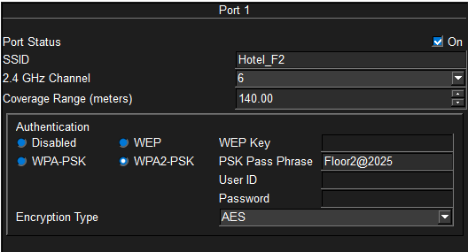
Access Switch Configuration
For Floor 2:

Slide 26
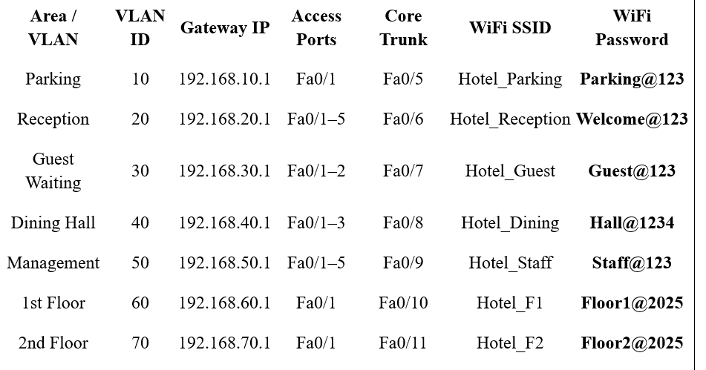
For
Wireless Device Connectivity

Slide 27
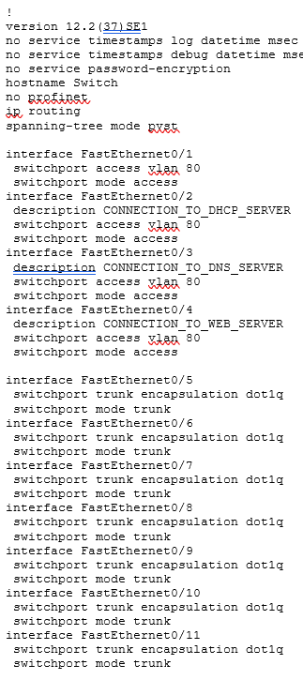
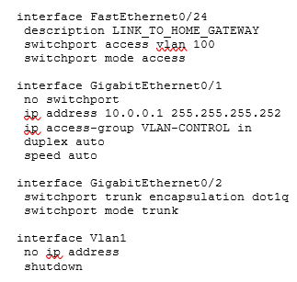
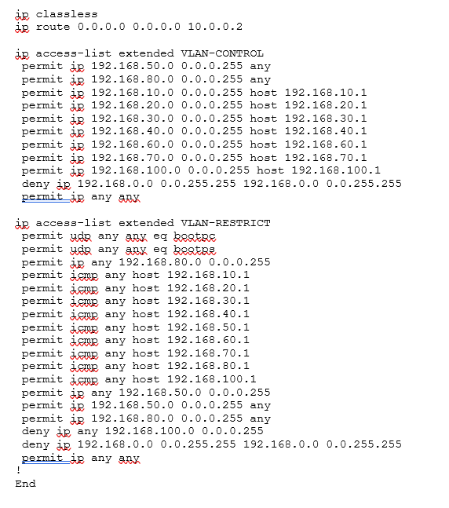
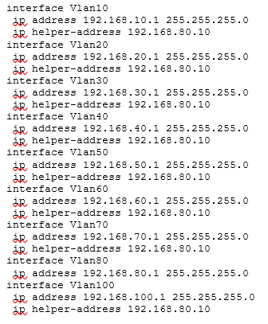
Core Switch Configuration

Slide 28
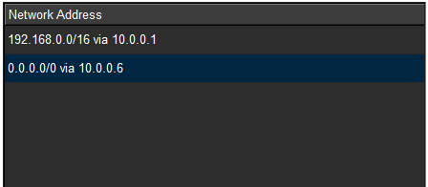
Core Router Configuration
Static routing implemented.
Routes internal VLAN traffic toward core switch.
Default route points toward firewall.
Static iP Addressing applied successfully!!

Slide 29
Core Router Running Configuration (CORE-RTR)
!
version 15.1
no service timestamps log datetime msec
no service timestamps debug datetime msec
no service password-encryption
hostname Router
ip cef
no ipv6 cef
interface GigabitEthernet0/0
ip address 10.0.0.2 255.255.255.252
duplex auto
speed auto
interface GigabitEthernet0/1
ip address 10.0.0.5 255.255.255.252
duplex auto
speed auto
interface GigabitEthernet0/2
shutdown
ip classless
ip route 192.168.0.0 255.255.0.0 10.0.0.1
ip route 0.0.0.0 0.0.0.0 10.0.0.6
!
end

Slide 30
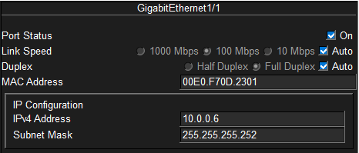
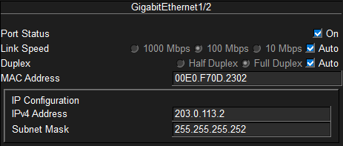
Firewall (ASA 5506) Implementation

Slide 31
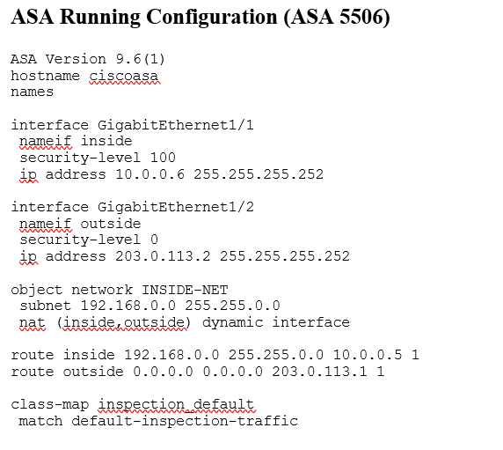
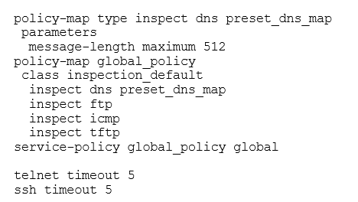

Slide 32
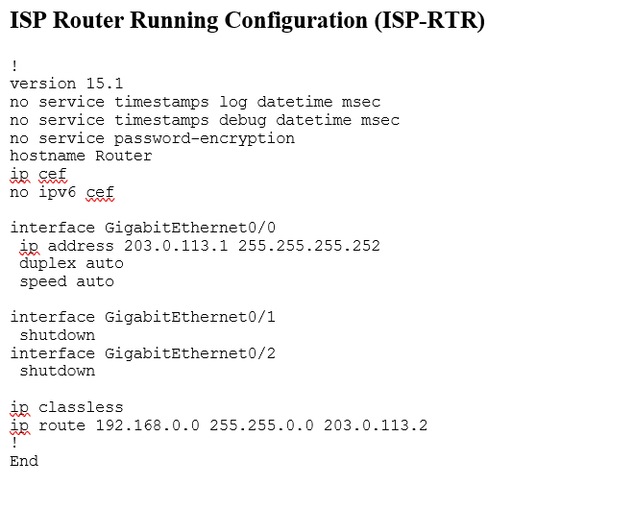

Slide 33
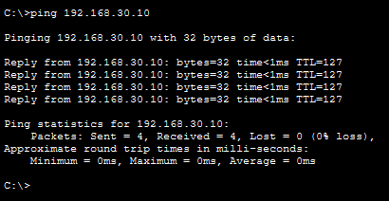
Network Testing & Verification
Ping tests verify inter-VLAN connectivity.
End devices successfully access servers and internet.
We contacted a PC from Guest-Lounge having ip-Address: 192.168.0.10
from our main IT System PC and it was successful:

Slide 34
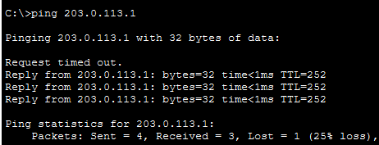
Internal Network to Isp:
Ping test:
From our Admin Device To ISP Router and it was successful:
Result:
Firewall Block Generate the Log.
Firewall Log:

Slide 35
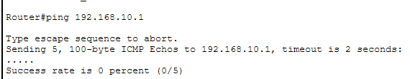
ISP To Internal Network :
Ping test:
From ISP Router To our Internal Netrork and it was
Blocked By the Firewall
Result:
Firewall Block The outsite Trafic
Ping 192.168.10.1

Slide 36
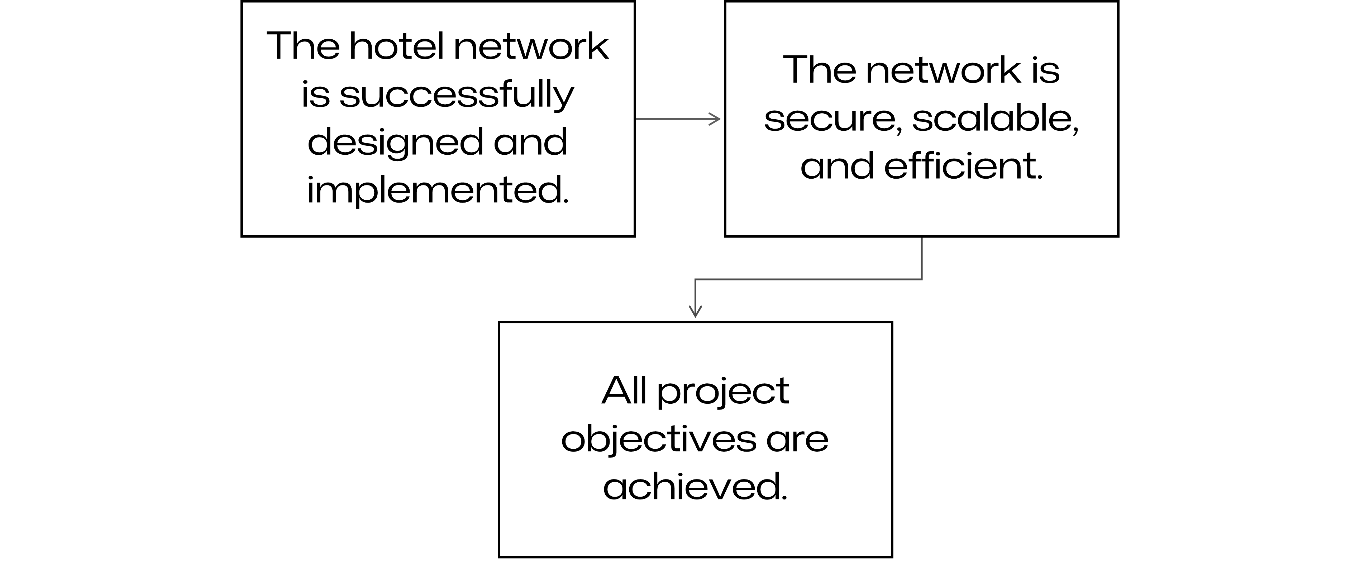
Conclusion:

Slide 37

Questions

